Slide 1

Bhopal Pole Kiosks
Branding
5000 Pole Kiosks Across Bhopal

Slide 2
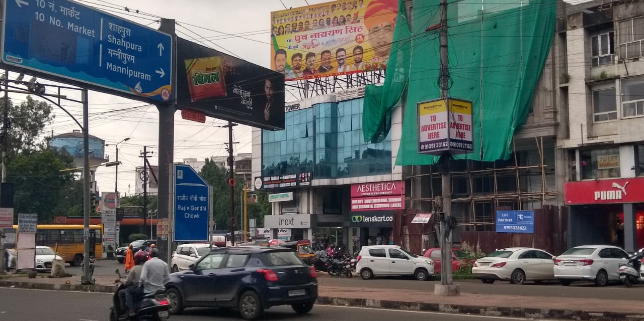
Bitten Market
Four Sided Pole
Size:- 3X4 (Backlit)

Slide 3
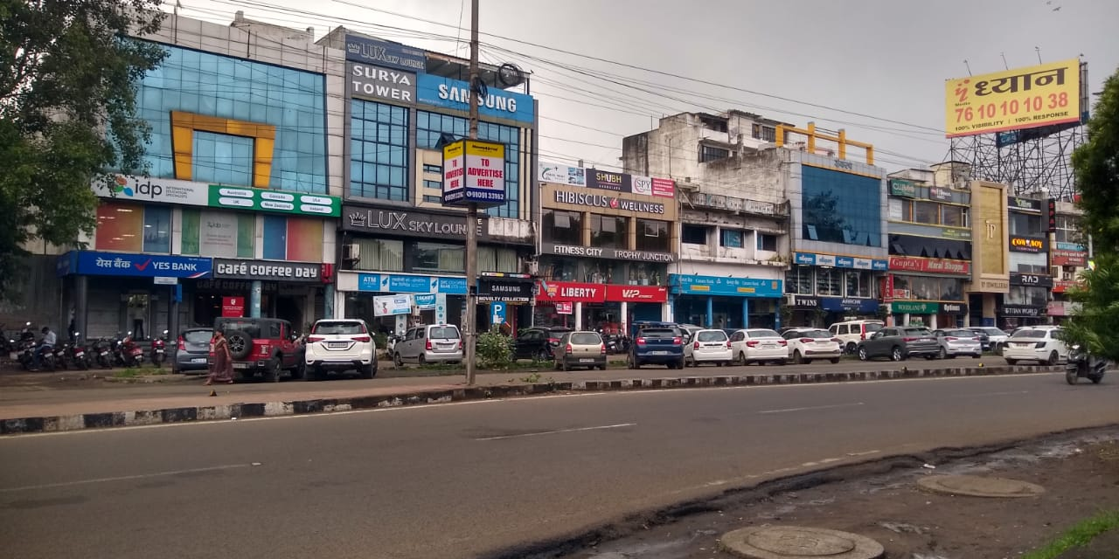
Bitten Market
Four Sided Pole
Size:- 3X4 (Backlit)

Slide 4
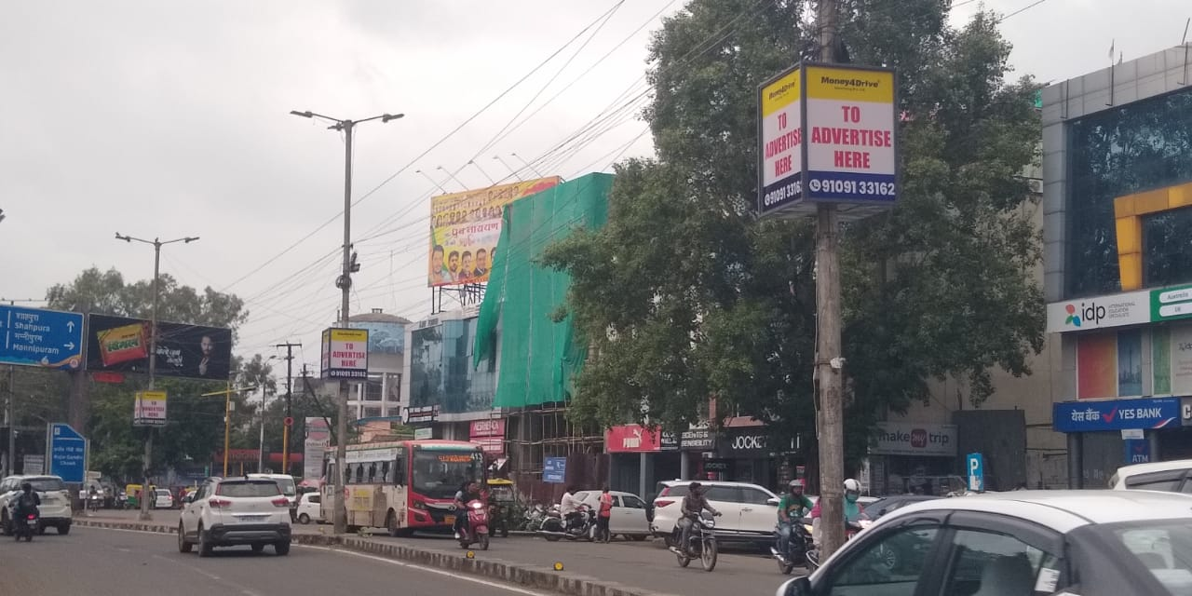
Bitten Market
Four Sided Pole
Size:- 3X4 (Backlit)

Slide 5
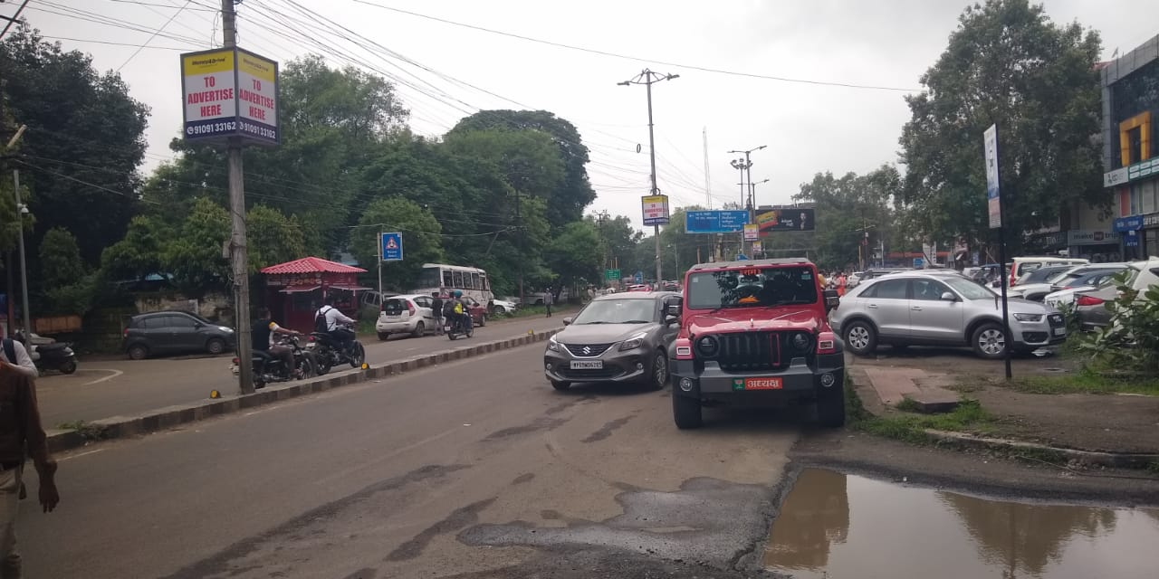
Bitten Market
Four Sided Pole
Size:- 3X4 (Backlit)

Slide 6
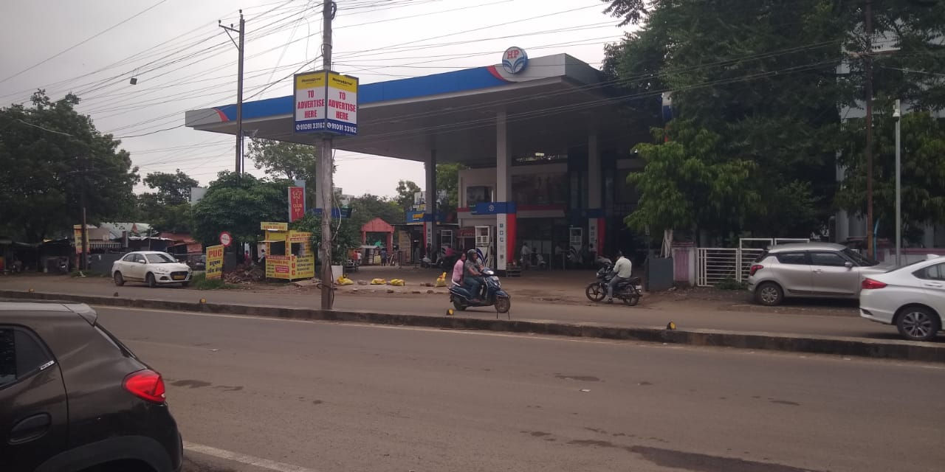
Bitten Market
Four Sided Pole
Size:- 3X4 (Backlit)

Slide 7
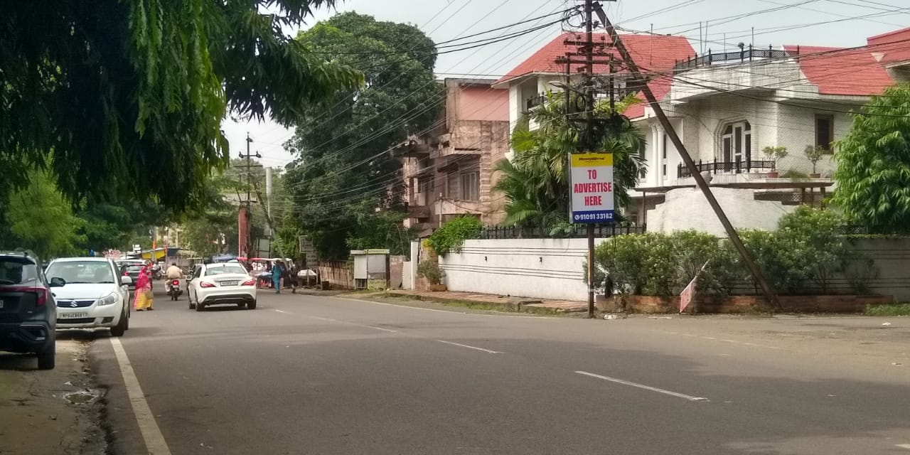
Arera Colony (E-2)
Size:- 3X5 Backlit

Slide 8
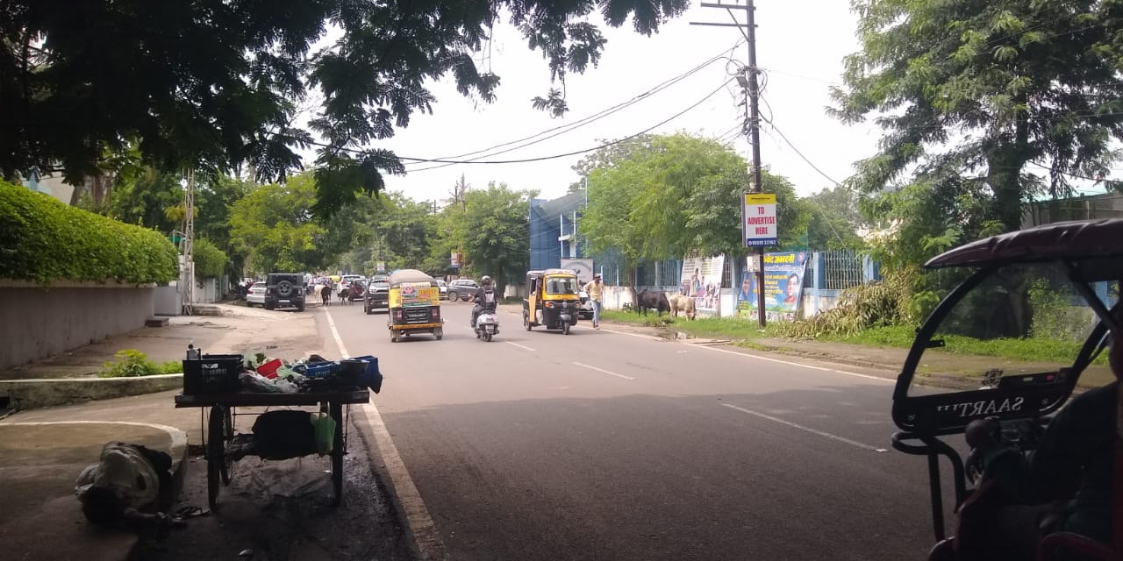
Arera Colony (E-2)
Size:- 3X5 Backlit

Slide 9
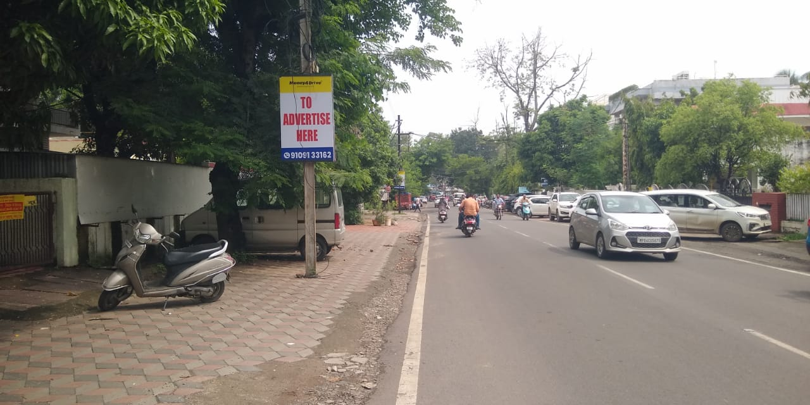
Arera Colony (E-2)
Size:- 3X5 Backlit

Slide 10
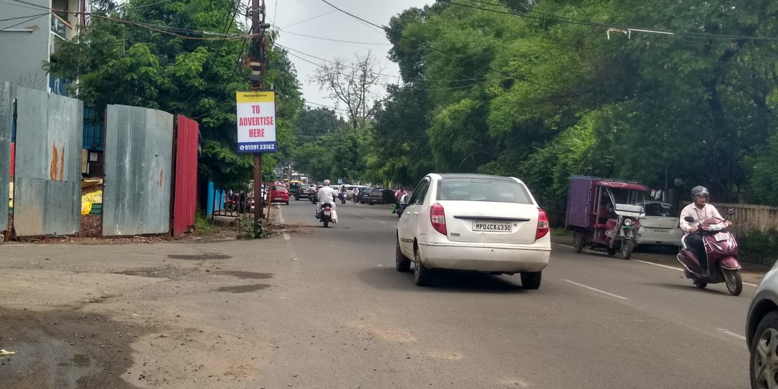
Arera Colony (E-2)
Size:- 3X5 Backlit

Slide 11
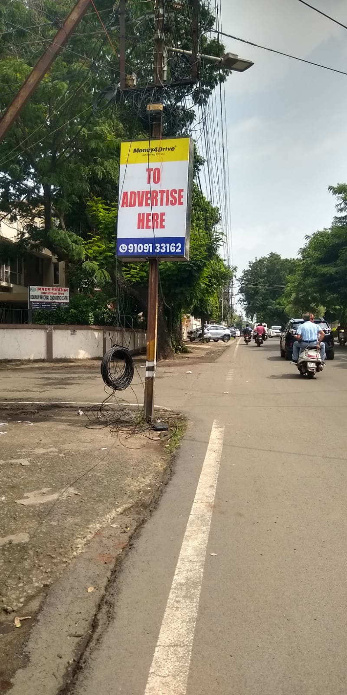
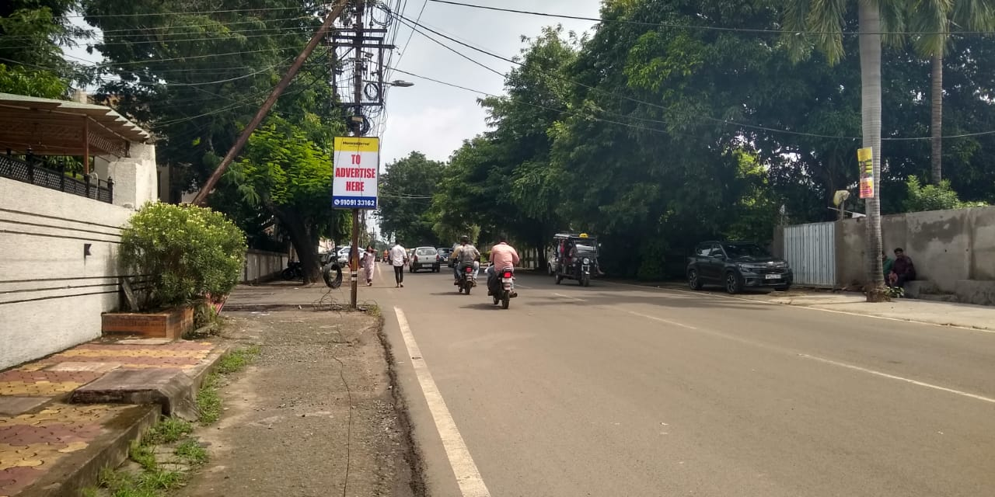
Arera Colony (E-2)
Size:- 3X5 Backlit

Slide 12
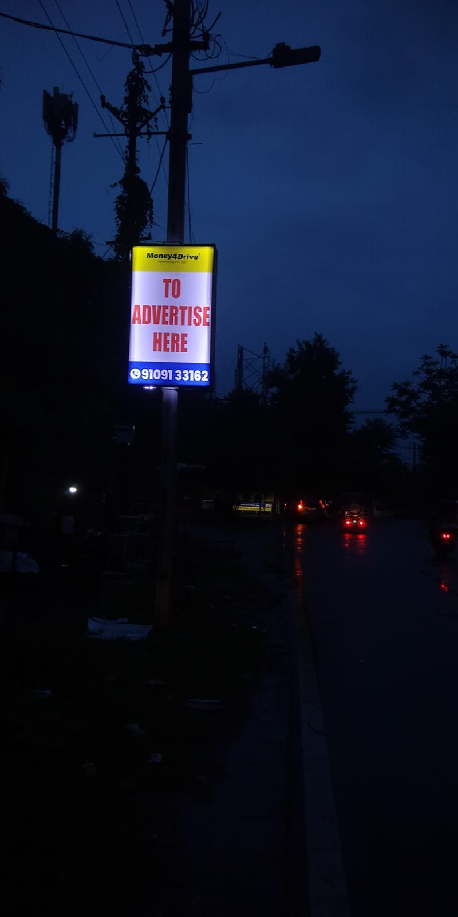
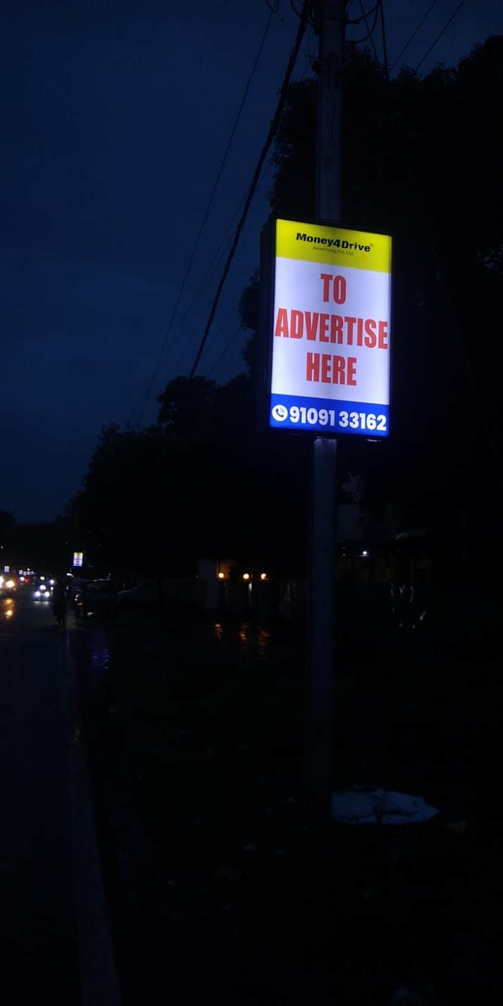
Campion School
Size:- 3X5 Backlit

Slide 13
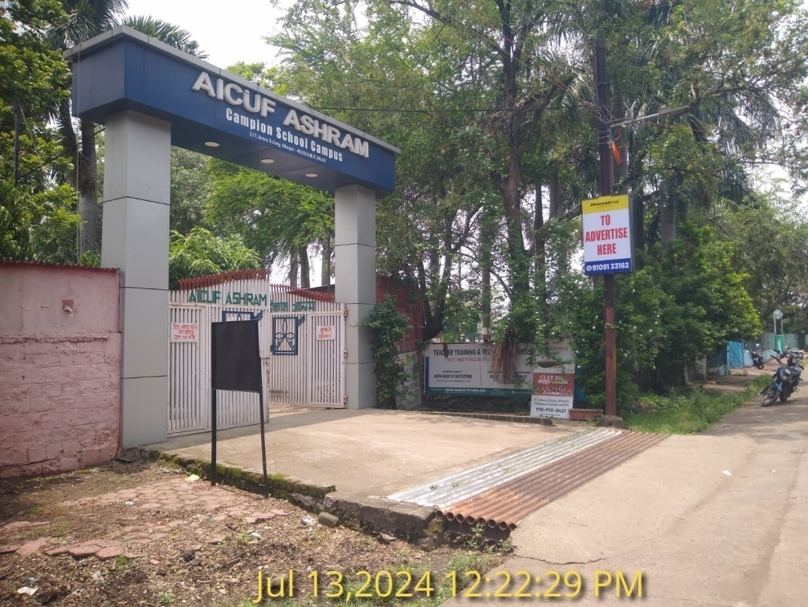
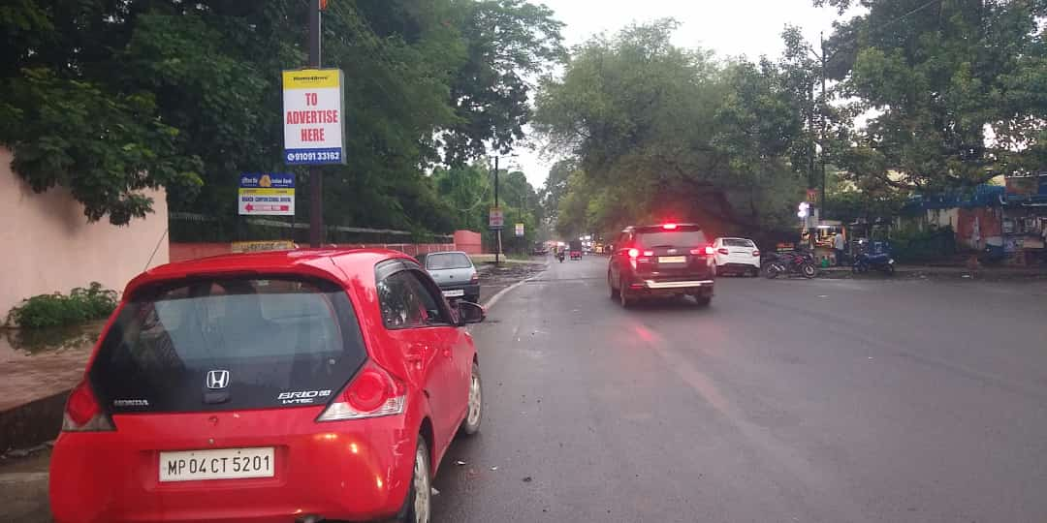
Campion School
Size:- 3X5 Backlit

Slide 14
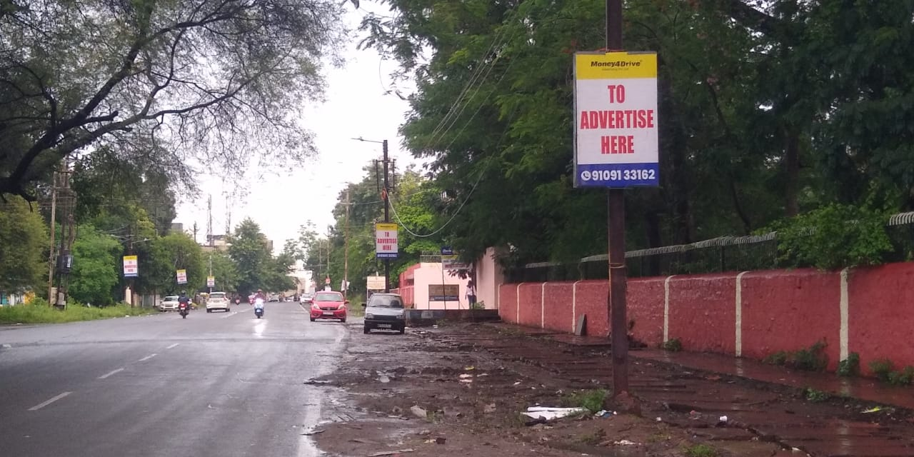
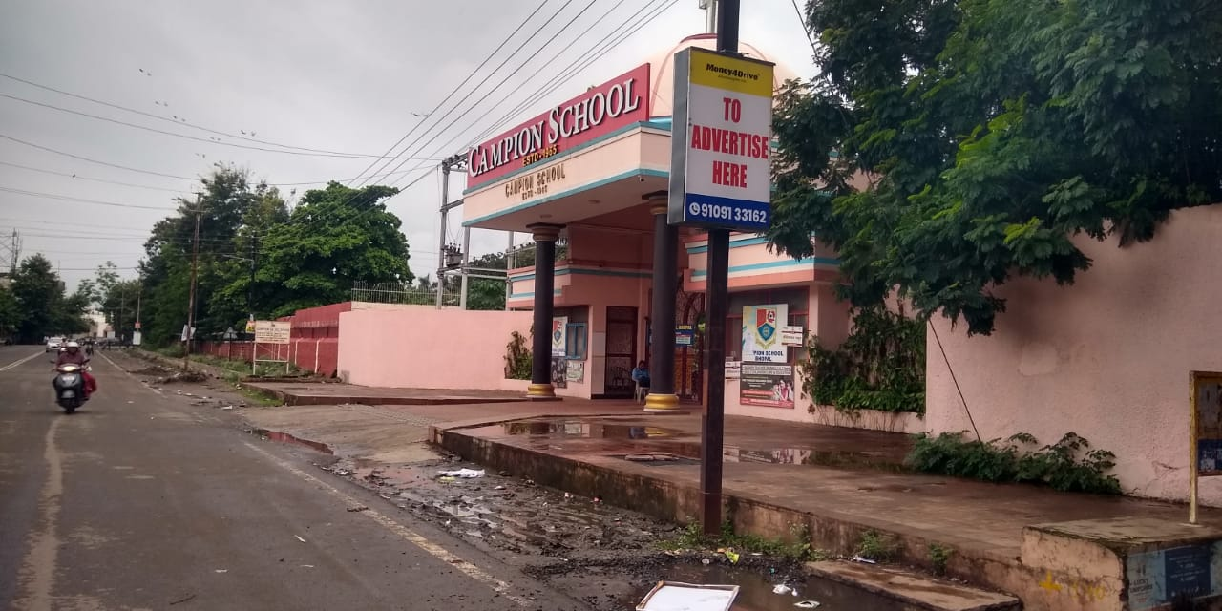
Campion School
Size:- 3X5 Backlit

Slide 15
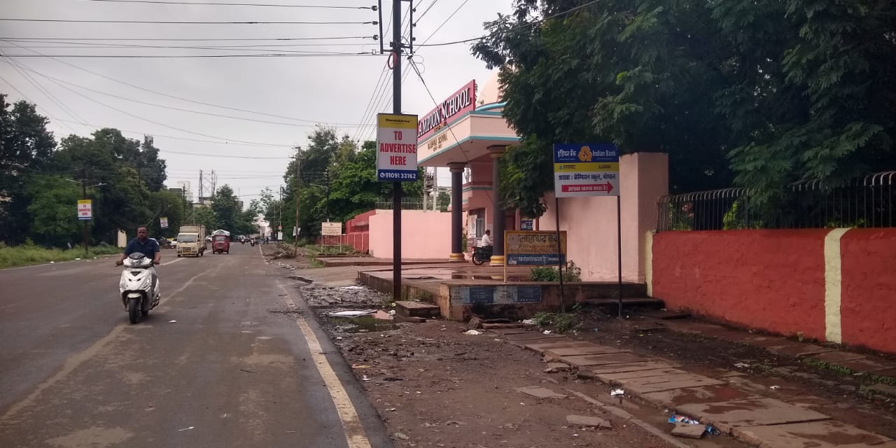
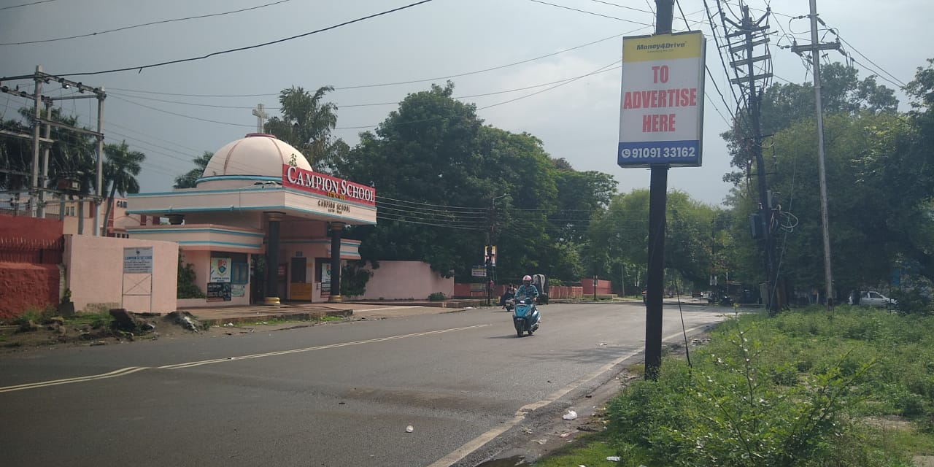
Campion School
Size:- 3X5 Backlit

Slide 16
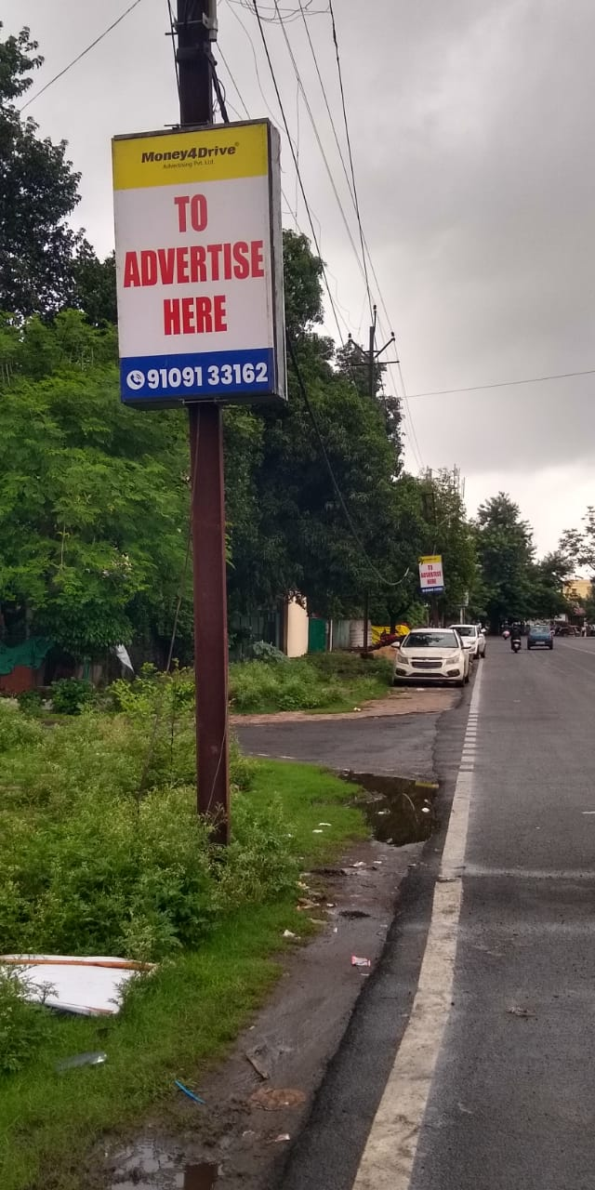
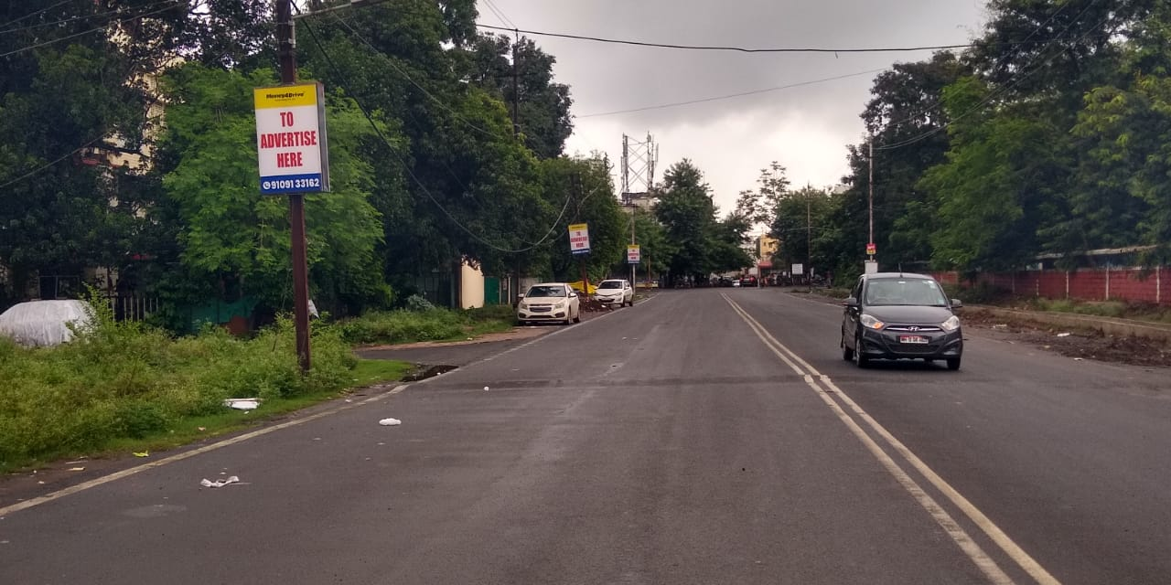
Campion School
Size:- 3X5 Backlit

Slide 17
Campion School
Size:- 3X5 Backlit

Slide 18
Campion School
Size:- 3X5 Backlit

Slide 19
Campion School
Size:- 3X5 Backlit

Slide 20
Campion School
Size:- 3X5 Backlit

Slide 21
Campion School
Size:- 3X5 Backlit

Slide 22
Thanking you
Call For Advertising
Contact :- 91091 33162

